Slide 1
Nothing Changes, If Nothing Changes!
Trisha Zulic-SHRM-SCP
SHRM Facilitator
Efficient Edge
HR Consultancy

Slide 2
Sound Familiar?

Slide 3
To have work-life balance with your employees, you must have it for yourself first!
Perspective

Slide 4
How do we balance, fairness and equality with business reality
The Balancing Act
HR knows what needs to be done and for X reason the company does not want to go that direction
Management continues to communicate and behave in a manner that creates risk
The paper, all the paper, all the filing….I got my HR certification to work in a strategically at a leadership level not deal with paper
I’m answering emails at night and on the weekend
I’m a department of one, who is going to do all of this
No one understands HR

Slide 5
Married to work?
Consider the Cost
Fatigue.
Poor health.
Lost time with friends and loved ones.
Increased expectations.
Notes:
Credit the Mayo Clinic
It can be tempting to rack up hours at work, especially if you're trying to earn a promotion or manage an ever-increasing workload — or simply keeping your head above water. If you're spending most of your time working, though, your home life will take a hit.

Slide 6
Don’t get a divorce just manage visitation!
Setting limits
Manage your time.
Learn to say no.
Leave work at work.
Reduce email access.
Take advantage of your options.
Try to shorten commitments and minimize interruptions.

Slide 7
Things Change! Have you?
Where are these brands now?!
Notes:
All of these brands were once #1. Think about Kodak, they failed to think that one day people would not need film and where are they now with that thought process. How do we apply this with the HR brand and our day to day responsibilities.

Slide 8
Are you doing what you are doing because you have always done it that way?!
Change Management
Notes:
Or do you fear change? Story
An seasoned HR Professional recently took a new role. The company had all their files in the cloud, her first day she proceeded to print everything, create folders, binder for I9’s and benefit files. I asked her why….and the answer was…”I have always done it that way”.

Slide 9
The Factory Inside
HR, Payroll & Benefit Departments have a factory inside of it, processes that are followed and items produced for a customer.

Slide 10
The Factory Inside HR
Examples
Hiring, benefits administration, employee review administration and relocation are just some. Even if that non-value added step only wastes 6 minutes, if it happens 100 times a year how much time was that?! If your process has 50 of these non-value added steps you can give yourself 500 hours a year to do higher level work, that will improve your organization’s performance.
Notes:
When was the last time you went through the hiring process as if you were a new hire, not on the other side watching?!
When was the last time you performed the tasks you are asking of your management?
When was the last time you performed the tasks of the job descriptions that you have written, seriously spent a day in another persons shoes?!

Slide 11
Your Customers!
Admin & Line Employees – Internal Customer
Managers and Supervisors – Internal Customer
Executives and The Board – Internal Customer
Work Product or Service – External Customer
Potential Team Members – External Customer
Notes:
Why is this so important? Discussion regarding customer service/solutions and the perception and decision you make within seconds of interacting with customer service/solutions. How does customer service for internal and external customers impact your work/life balance.

Slide 12
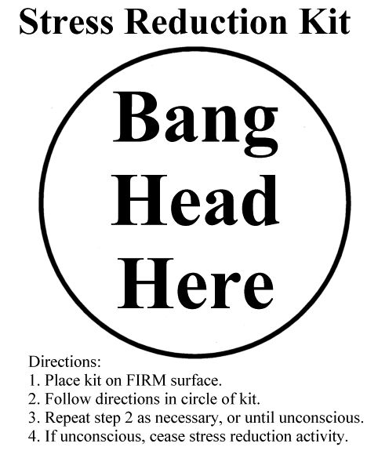
What frustrates your internal customers?
What frustrates you from your internal customers?
What cannot be improved due to lack of budget?
What has not been changed or process improved in over a year?
Notes:
Group excercise by table

Slide 13
Managing Your Own Expectations!
What Do You Want for Yourself?
More Compensation
More Appreciation
Next Level Leadership
Where do I go from here
More “C” Suite Interaction
I’m a department of one
Notes:
What would you tell your employees if they asked you for any one of these things?

Slide 14
Who are you now? Who do you want to be? What do you want to be doing? What do you want to earn doing it?
Group Exercise

Slide 15
Do I need to include a cat?!
Sample Lean Six Sigma Communication Solutions
40% prefer email communications
20% prefer a memo
10% prefer face to face
30% prefer social media
Instagram: Pictures of Benefit Documents
Twitter: Reminders and basic communications
Facebook HR Page: Basic Communications
You Tube: Password protected videos from HR
Notes:
Story:
Director of HR for 73 Dennys that had promoted their best line employees to management-meaning they knew how to get the work done, but not how to motivate people to do the same.

Slide 16
Transformation Tools!
Certificate in Mediation
SHRM California Employment Law Credential
SHRM Recruiting Credential
SHRM Department of One Credential
Project Management Certification
Accounting Certification
Professional Profile and Brand
Participating in your profession Board position or volunteering

Slide 17
Website Tools!
Website: Leadership Now
Website: Mindtools
Website: SHRM
Website: Character Counts
Website: Linked In

Slide 18
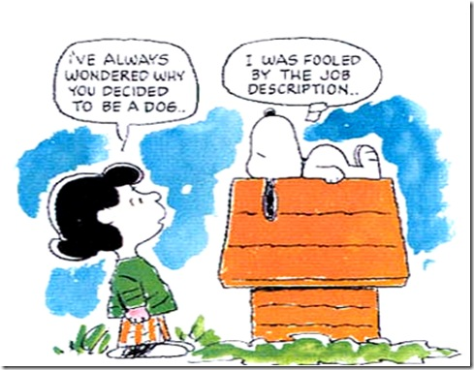
Questions
Thank you!

